Slide 1
ADAPTIVE TRAFFIC LIGHT TECHNOLOGY
ATHUL ROY
1NH19CS708
3E
MINI PROJECT

Slide 2
OBJECTIVES OF THE COURSE
To apply the knowledge on the operations of various data structures.
Student should be able to design and implement an algorithm for the chosen problem statement
To create a software solution for real time application using one or more data structures.

Slide 3
ABSTRACT
Adaptive traffic light portal is a program which can be implemented to any intersection where there is need of traffic lights for traffic flow. This program is very adaptive so that same program can be used at any intersection.
Traditionally traffic lights run on a pre-set time cycle, this system is slow and inefficient as time which can be used to clear busy road is wasted on a road with very less traffic.
This creates great confusion which leads to more accidents. Adaptive traffic light portal will calculate the most efficient time for each road at the intersection comparing the traffic on all roads. It will also signal pedestrian crossing at the best efficient time. And also Amber(Yellow) lights can be set up if needed.

Slide 4
OBJECTIVES
Easy way to conduct traffic through an intersection.
Automate the adaptive sequence of traffic lights based on traffic density.
Flexible system which is adaptable to most scenarios.
Safe and fast progression of traffic and pedestrians at major accident prone intersections.

Slide 5
PROBLEM STATEMENT
The roads are getting crowded than ever as people try to get to places faster and efficiently, the old and slow traffic control system can barely keep up with this increase in vehicles. People usually get annoyed by this slow way of traffic control and it eventually lead to an accident. This system will adapt itself to the density of the traffic giving a faster flow of traffic thorough the intersection thus lowering number of accidents.

Slide 6
FUNCTIONALITY
Circular linked list is in this system as the linked list has a self referential structure, it has made it possible to add any number of fields such as the light and density.
The various functionalities of the linked list such as insertion, searching and display has made it possible to perform functions like maintaining each roads time stamps, allowing to change the lights as needed and density of each road.
The various functionalities of the linked list such as insertion, searching and display has made it possible to perform functions like creating the intersection, travel the list to get the lights for each road.

Slide 7
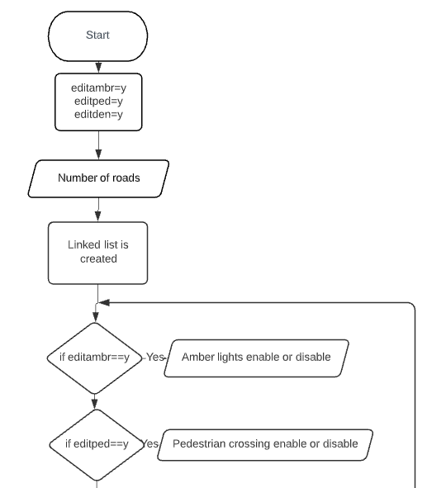
FLOW CHART

Slide 8
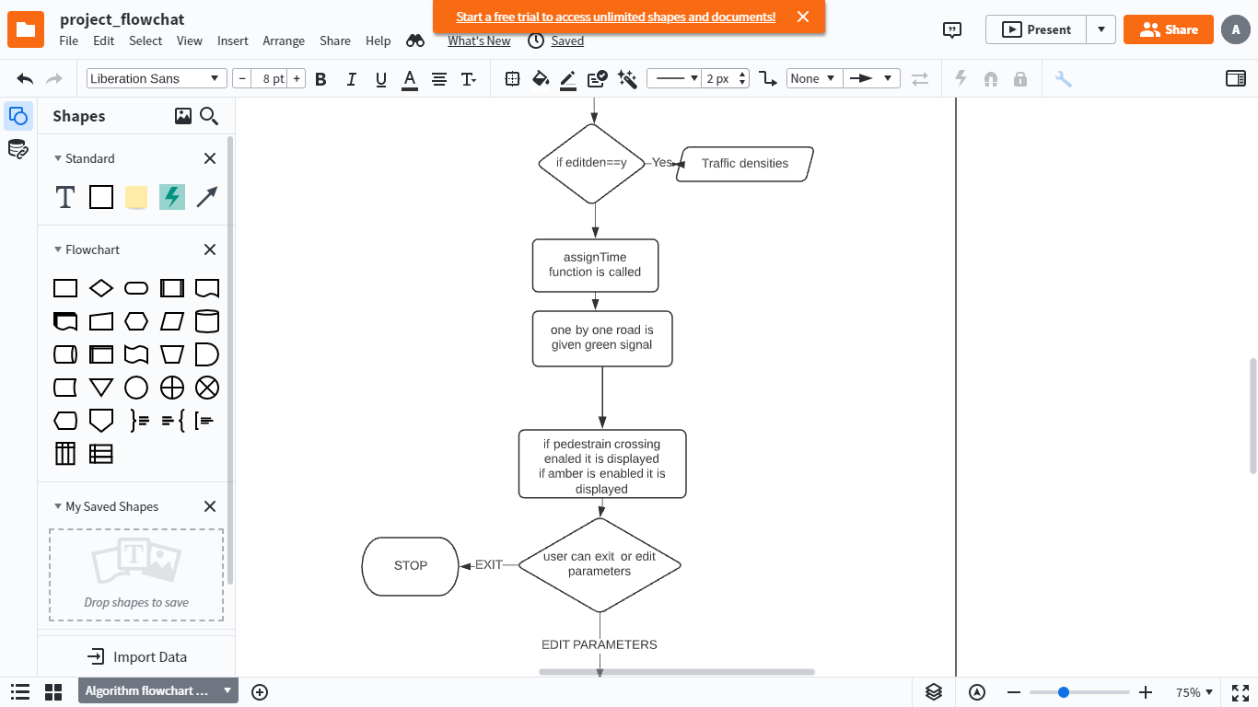

Slide 9
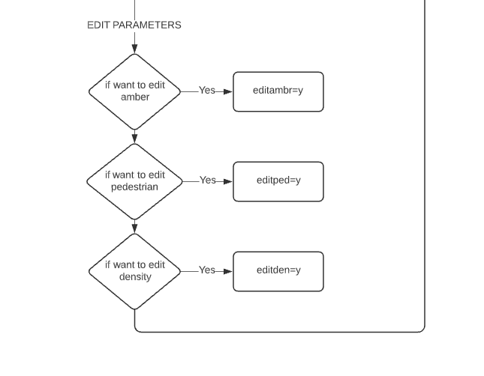

Slide 10
ALGORITHM
Step 1:- Program starts
Step 2:- Input of number of roads at the intersection.
Step 3:- Input of status of pedestrian crossing and time .
Step 4:- Input of status of amber light between green and red light changes.
Step 5:- Input of the traffic density in terms of the road capacity (in percentage).
Step 6:- According to the information user has provided the program creates and builds up a circular singly linked list and stores the time stamps.
Step 7:- Depending on the input linked list is altered to enable pedestrian crossing and amber lights changes for example for pedestrian crossing all roads will be signaled to stop for the said time. And if amber lights are requested then between every light chance from green to red or red to green 4 secs amber is shown.

Slide 11
Step 8:- Finally the linked list is run through a loop and gets displayed on the screen with the time the green light should be kept on and then the linked list is altered after every cycle so that the same linked list can be reused.
Step 9:- Now the user has the option to edit the parameters of the intersection like if the user wants to enable or disable pedestrian crossing due to change in the pedestrian density, or user wants to add/remove the amber lights or the user wants to change the road densities when the traffic density changes. If the user wants to edit the above parameters he will be redirected to previous interface where user can enter the new details and get output. Or the user can exit the program here.
Step 10:- Program exits.

Slide 12
METHODOLOGY
The methodology used in the program is based on the theory of circular linked list and array.
The basic idea of this program is to consider the lights on every road at the intersection as a circular singly linked list taken in order this is to facilitate the implementation of traffic density based traffic light sequence. And each roads time stamps are stored in the linked list’s fields

Slide 13
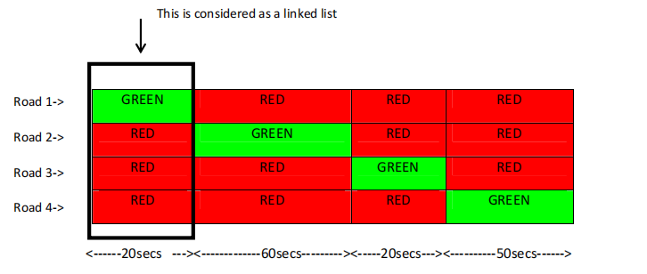

Slide 14
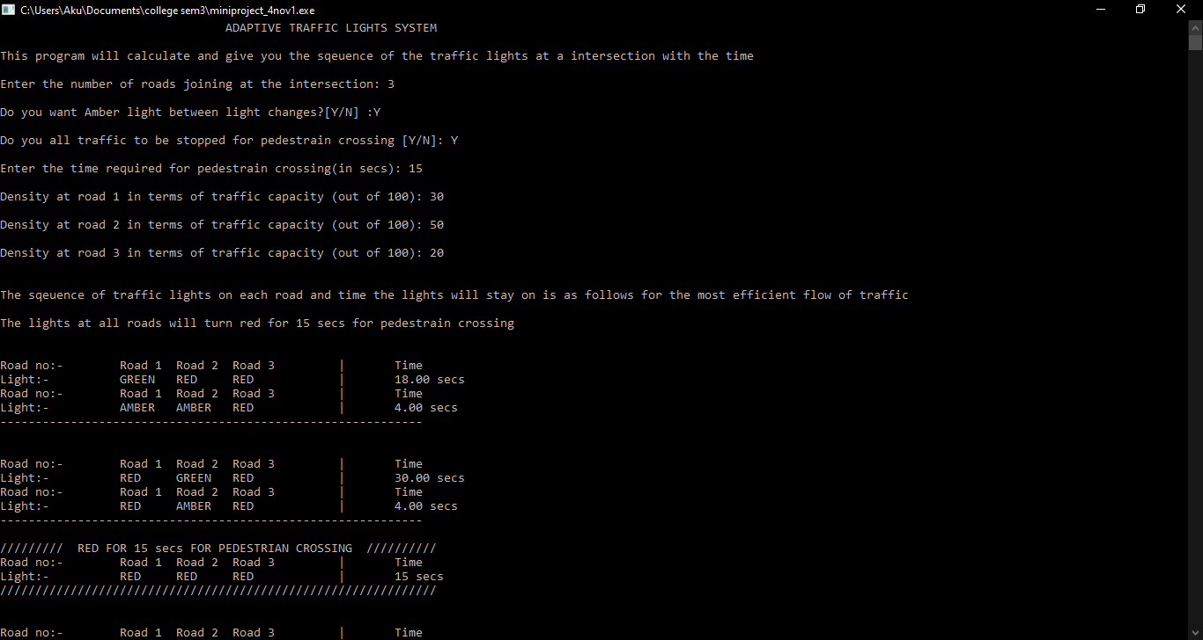
SAMPLE OUTPUT

Slide 15
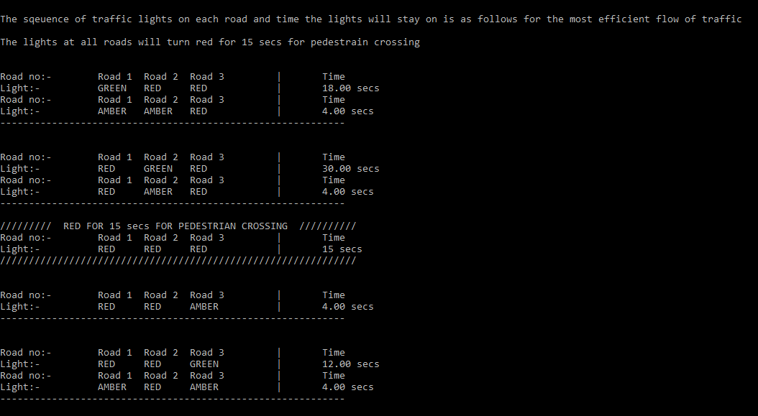

Slide 16
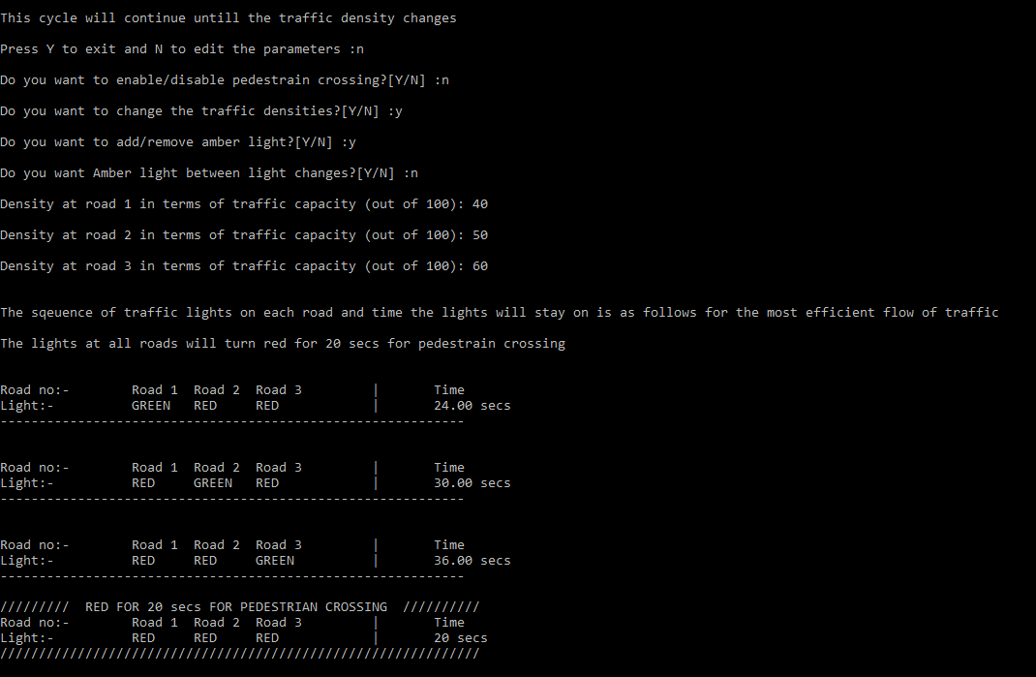

Slide 17
HOW DID I ACHIEVE THE OBJECTIVES OF MY PROJECT?
The program will calculate and show the traffic lights at each road and the time each cycle of lights should stay on.
Giving the option of stopping all traffic for pedestrian crossing for a safe passage of pedestrians and traffic and option of amber lights.
The intersection details are stored using a circular linked list, the linked list can be traversed to find details to display the sequence of lights at the intersection.
As conditions change as time passes the inputs can be altered to provide the best sequence of lights. Preferably they changes can be taken in by picture recognition systems to improve this system.
As vehicle has to spend less time idling waiting for green signal, leading to lesser emissions of green gases.

Slide 18
THANK YOU

